Slide 1





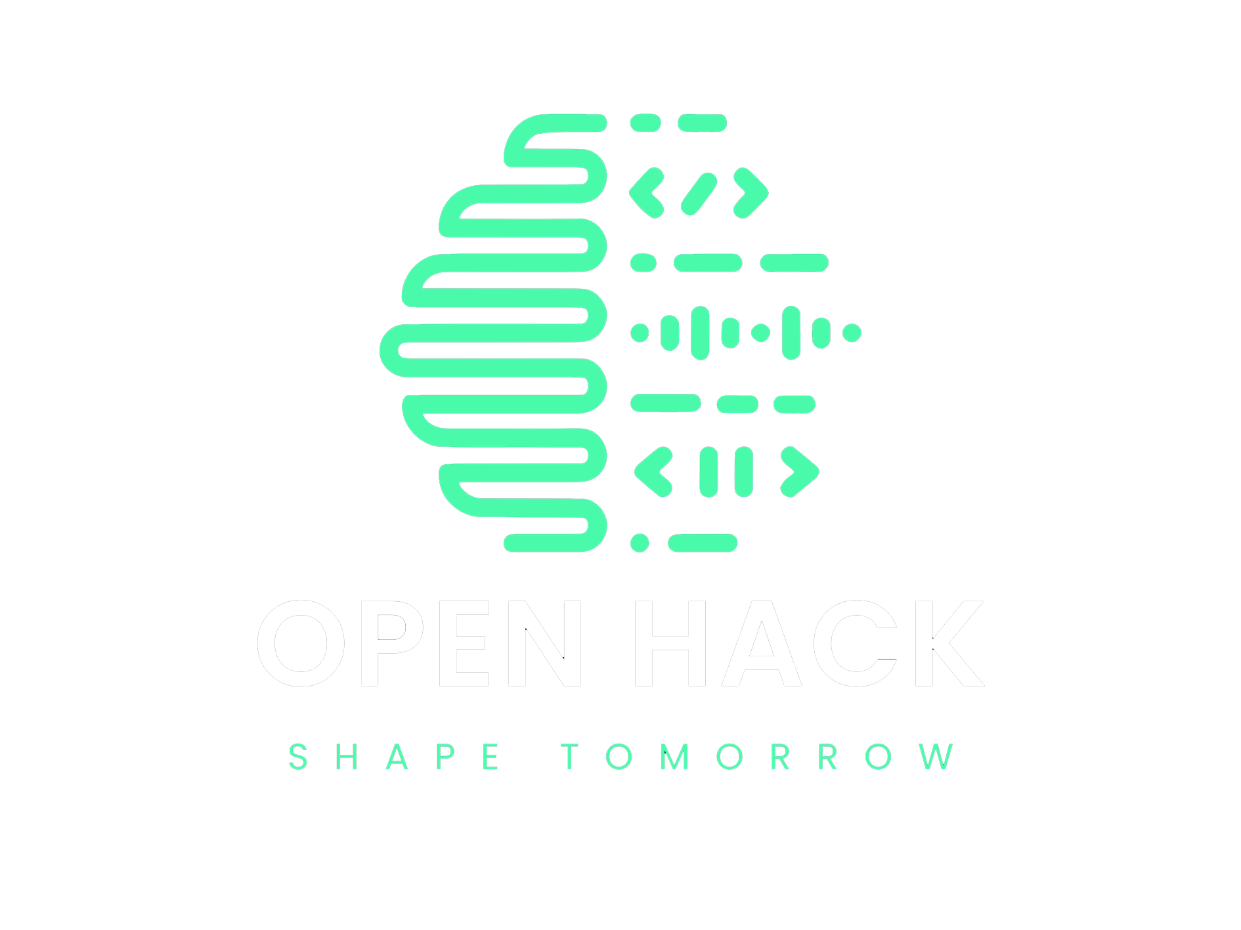
TEAM DETAILS AND PROBLEM STATEMENT
Instant parser for different types of blood reports in India
Problem Statement :
Team Name :
Team Leader Details (Name, Phone Number, Email) :
Institution Name :
Course Enrolled :
CHASING THAT FEELING
Sai Kiran Patnana, 6300006765, saikiranpatnana5143@gmail.com
Rajiv Gandhi University of Knowledge Technologies, Nuzvid
Computer Science and Engineering

Slide 2
Problem Statement & Goal
Design and enforce an AI-driven parser that can accurately interpret results from various blood reports.
Objectives:
1. Quick extraction of essential parameters from the blood reports.
2. An EHR (Electronic Health Report) as the output.
3. Orientation towards Indian diagnosing laboratories.
Creating an AI-driven web application which can be used by both patients and doctor, anytime to get insights of the medical report in an instant.

Slide 3
Process Flow
Parser
Parses the document
Plotter
Plots the abnormalities
User
Model
Uploads a medical report
Generates insights and recommendations
Interacts with chatbot
Recommendations
Chatbot

Slide 4
Methodology
Data Collection & Preprocessing – Extract blood report data using OCR + NLP.
AI Parsing & Feature Extraction – Identify key medical parameters from reports.
Abnormality Detection & Visualization – Highlight deviations using graphs & charts.
Self-Analytical Chatbot – Provides adaptive insights for doctors & patients.
EHR Generation & Secure Storage – Converts reports into structured health records.
Smart Recommendations – AI-driven diet, lifestyle, and medication advice.

Slide 5




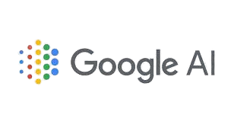




Technology Stack
Tesseract
LangChain
Google Gen AI
Chat GROQ
Flask
HTML
CSS
JavaScript
Python

Slide 6
Uniqueness
Instant AI Parsing – Adapts to Indian blood report formats for quick data extraction.
Abnormality Visualization – Highlights deviations using graphs & charts.
Self-Analytical Chatbot – Interprets reports & provides real-time insights.
Dual-Mode Interaction – Doctors get technical details , patients get simplified advice.
EHR Generation & Storage – Creates structured health records for tracking.
Smart Health Recommendations – Suggests diets, lifestyle changes, & next steps.
Privacy-Focused AI – Secure & encrypted patient data management.

Slide 7
Use Cases
For Patients: Instant health insights, trend tracking, and personalized recommendations.
For Doctors: Faster diagnosis, structured EHRs, and telemedicine support.
For Labs: Standardizing diverse report formats across Indian diagnostic centers.
For Public Health: Disease trend analysis and policy support.
For Insurance & Corporates: Faster claim processing and employee wellness programs.

Slide 8
Future Work
Making it available in Mobile platforms
Increasing efficiency and speed
Making it versatile

Slide 9
Important Pointers
Kindly keep the maximum slides limit to 8 pages.
All the topics should be utilized for the description of your idea.
Try to avoid paragraph and post your idea in points and keep your explanation precisely and easy to understand.
You need to save the file in PDF and upload the same on portal. No PPT, Word Doc or any other format will be supported.
You can delete this slide (Important Pointers) when you upload the details of your idea on Hackathon platform.
Mention the Link of Video (publically accessible)

